Slide 1

MEDICAPS UNIVERSITY
2019-2020
Internship at Free Wings Power and Infra Ltd.
Project title: Prediction of solar and wind generation
External Guide/Incharge
Ajay Porwal
Internal Guide:
Ms. Ruchi Patel & Mr.Sachin Solanki
(Asst. professor CS Department)
Submitted By:
Tanisha Jain(EN16CS2301275)

Slide 2
INDEX
ABOUT THE COMPANY
DATA VISUALIZATION
EXPLORATORY DATA ANALYSIS
MY PROJECT

Slide 3
ABOUT THE COMPANY
FREEWINGS POWER & INFRA LIMITED is a 28.11 Years old, PublicUnListed Indian Non-Government Company. As per MCA and other Industry classification records, the main line of business is Electricity; Gas; Steam And HOT Water Supply.
It is involved in Production , collection and distribution of electricity.
It sells the electricity to the government.

Slide 4
ABOUT MY PROJECT
I was given two datasets containing time series weather data and the energy generation values of past few years.
I was asked to predict wind and solar generation using Machine Learning from the forecast weather data.

Slide 5
Purpose of the project
One challenge with integrating renewable into the grid is that their power generation is intermittent and uncontrollable. Thus, predicting future renewable generation is important. In this project, “Predicting yearly wind and solar generation” I used linear regression and some other algorithms to predict renewable energy production from the given weather data and then compared the results. The aim to predict production on the basis of whether are as follows :
1. Know about the efficiency and profitability of the plant.
2. To predict the generation capability of a location which could be a possible new, project location.
3. To make changes in the design and use of the types of panels

Slide 6
These are the main goals to be accomplished by this project but there could be more uses to analyze the output.
Before this project I was give some Data Science related topics and concepts to understand and then implement as well.

Slide 7
^{DATA VISUALIZATION}
Data visualization is the discipline of trying to understand data by placing it in a visual context so that patterns, trends and correlations that might not otherwise be detected can be exposed.
Assignment: To apply Data Visualization on Iris Dataset.

Slide 8
DATA VISUALIZATION IN PYTHON
Python offers multiple great graphing libraries that come packed with lots of different features, to create interactive, live or highly customized plots. Few popular plotting libraries are:
Matplotlib.
Pandas Visualizations.
Seaborn.
Ggplot.
Plotly.

Slide 9
How to create basic plots using Matplotlib and Seaborn
Importing Datasets
import pandas as pd
iris = pd.read_csv('iris.csv', names=['sepal_length', 'sepal_width', 'petal_length', 'petal_width', 'class'])
print(iris.head())
wine_reviews = pd.read_csv('winemag-data-130k-v2.csv', index_col=0)
wine_reviews.head()

Slide 10
MATPLOTLIB
Matplotlib is the most popular python plotting library. It is a low-level library with a Matlab like interface which offers lots of freedom at the cost of having to write more code.
To install Matplotlib, pip and conda can be used
pip install matplotlib or
conda install matplotlib
Matplotlib is specifically good for creating basic graphs like line charts, bar charts, histograms and many more. It can be imported by typing:
import matplotlib.pyplot as plt

Slide 11
1.Scatter Plot
To create a scatter plot in Matplotlib we can use the scatter method. We will also create a figure and an axis using plt.subplots so we can give our plot a title and labels.
fig, ax = plt.subplots()
# scatter the sepal_length against the sepal_width
ax.scatter(iris['sepal_length'], iris['sepal_width'])
# set a title and labels
ax.set_title('Iris Dataset')
ax.set_xlabel('sepal_length')
ax.set_ylabel('sepal_width')
We can give the graph more meaning by coloring in each data-point by its class. This can be done by creating a dictionary which maps from class to color

Slide 12
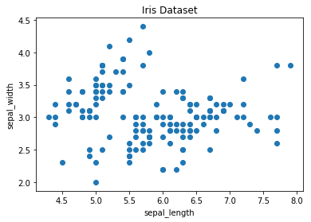
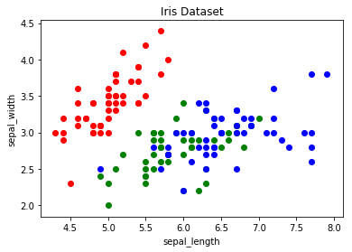
Matplotlib scatter plot

Slide 13
2.LINE CHART
In Matplotlib we can create a line chart by calling the plot method. We can also plot multiple columns in one graph, by looping through the columns we want and plotting each column on the same axis.
columns = iris.columns.drop(['class'])
# create x data
x_data = range(0, iris.shape[0])
#create figure and axis
fig, ax = plt.subplots()
# plot each column
for column in columns:
ax.plot(x_data, iris[column], label=column)
# set title and legend
ax.set_title('Iris Dataset')
ax.legend()

Slide 14
3.HISTOGRAMS
In Matplotlib we can create a Histogram using the hist method. If we pass it categorical data like the points column from the wine-review dataset it will automatically calculate how often each class occurs.
fig, ax = plt.subplots()
ax.hist(wine_reviews['points'])
ax.set_title('Wine Review Scores')
ax.set_xlabel('Points')
ax.set_ylabel('Frequency')

Slide 15
4.BAR CHART
A bar chart can be created using the bar method. The bar-chart isn’t automatically calculating the frequency of a category so we are going to use pandas value_counts function to do this. The bar-chart is useful for categorical data
fig, ax = plt.subplots()
data = wine_reviews['points'].value_counts()
points = data.index
frequency = data.values
ax.bar(points, frequency)
ax.set_title('Wine Review Scores')
ax.set_xlabel('Points')
ax.set_ylabel('Frequency')

Slide 16
Seaborn
Seaborn is a Python data visualization library based on Matplotlib. It provides a high-level interface for creating attractive graphs.
Seaborn has a lot to offer. You can create graphs in one line that would take you multiple tens of lines in Matplotlib. Its standard designs are awesome and it also has a nice interface for working with pandas dataframes.
We can import seaborn as : import seaborn as sns.

Slide 17
1.Scatter plot
We can use the .scatterplot method for creating a scatterplot, and just as in Pandas we need to pass it the column names of the x and y data, but now we also need to pass the data as an additional argument
sns.scatterplot(x='sepal_length', y='sepal_width', data=iris)
We can also highlight the points by class using the hue argument, which is a lot easier than in Matplotlib.

Slide 18
2.Line chart
To create a line-chart the sns.lineplot method can be used. The only required argument is the data, which in our case are the four numeric columns from the Iris dataset.

Slide 19
Exploratory data analysis
Exploratory Data Analysis or (EDA) is understanding the data sets by summarizing their main characteristics often plotting them visually. Plotting in EDA consists of Histograms, Box plot, Scatter plot and many more. It often takes much time to explore the data. Through the process of EDA, we can ask to define the problem statement or definition on our data set which is very important.
Assignment: Apply EDA on the given Car Dataset.

Slide 20
Steps taken to explore the data
1. Importing the required libraries for EDA
import pandas as pd
import numpy as np
import seaborn as sns #visualisation
import matplotlib.pyplot as plt #visualisation
%matplotlib inline
sns.set(color_codes=True)

Slide 21
2. Loading the data into the data frame.
As we can see that the value from the data set is comma-separated.
3. Checking the types of data.
Here we check for the datatypes because sometimes we have to convert that string to the integer data only then we can plot the data via a graph. Here, in this case, the data is already in integer format so nothing to worry.
df.dtypes

Slide 22
4. Dropping irrelevant columns
In this case, the columns such as Engine Fuel Type, Market Category, Vehicle style, Popularity, Number of doors, Vehicle Size doesn't make any sense to me so I just dropped for this instance.
5. Renaming the columns
This is a good approach it improves the readability of the data set.

Slide 23
6. Dropping the duplicate rows
6. Dropping the duplicate rows
7. Dropping the missing or null values.
8. Detecting Outliers
An outlier is a point or set of points that are different from other points. Sometimes they can be very high or very low. It’s often a good idea to detect and remove the outliers. Because outliers are one of the primary reasons for resulting in a less accurate model.

Slide 24
9. Plot different features against one another (scatter), against frequency (histogram)
Histogram
Heat map
scatterplot

Slide 25
MY PROJECT
Predicting wind generation through weather data.
Predicting solar generation through weather data.
Applying linear regression model.
Performance measurement using cross validation.
Use open weather map api to get forecast data
Build a desktop application in electronJS that gives generation for 5 days.

Slide 26
Predicting wind and solar generation from weather data using Machine Learning.
Using linear regression algorithm and a dataset containing energy production and weather information.
This project allowed me to deal with time series in a real-world context, as the data for the wind and solar generation and weather comes in hourly resolution.
It’s always an important lesson that some problems, even if they seem complicated, can be solved using simple techniques, in this case linear regression.
Devoid data set .

Slide 27

Read the dataset and Exploratory Data Analysis
Wind and solar generation
First, we start with the CSV file with the time series for the 37 regions from 2006 and 2017, but read only the data of ‘DE’ region as specified by mentor:
production = pd.read_csv("data/time_series_60min_singleindex.csv", usecols=(lambda s: s.startswith('utc') | s.startswith('DE')), parse_dates=[0], index_col=0)
‘DE_solar_generation_actual’, with the actual solar generation in MW;
‘DE_wind_generation_actual’, with the actual wind generation in MW.

Slide 28
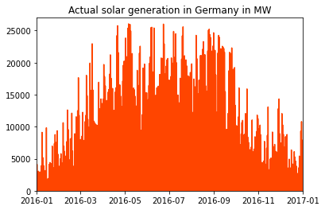
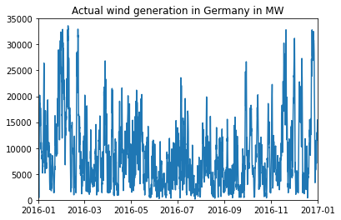
Plots to have an idea about the data.
As for the solar generation, as expected, it was significantly larger in the middle months of the year.
As we would naively expect, there is no clear pattern for the wind generation across the year, even though we can see slightly larger production roughly in February, November and December.

Slide 29
Weather Data
Now, we read the CSV file containing the weather data.
weather = pd.read_csv("data/weather_data_GER_2016.csv", parse_dates=[0], index_col=0)
After filtering for the rows for 2016, we end up with a DataFrame with 8784 and 48 columns, each relative to a different quantity such as solar radiation, wind velocity, etc
Wind parameters:
v1: velocity [m/s] at height h1 (2 meters above displacement height);
v2: velocity [m/s] at height h2 (10 meters above displacement height);
v_50m: velocity [m/s] at 50 meters above ground;
h1: height above ground [m] (h1 = displacement height +2m);
h2: height above ground [m] (h2 = displacement height +10m);
z0: roughness length [m];

Slide 30
Parameters Contd.
Solar parameters:
SWTDN: total top-of-the-atmosphere horizontal radiation [W/m²];
SWGDN: total ground horizontal radiation [W/m²];
Temperature data:
T: Temperature [K] at 2 meters above displacement height (see h1);
Air data:
Rho: air density [kg/m³] at surface;
p: air pressure [Pa] at surface.

Slide 31
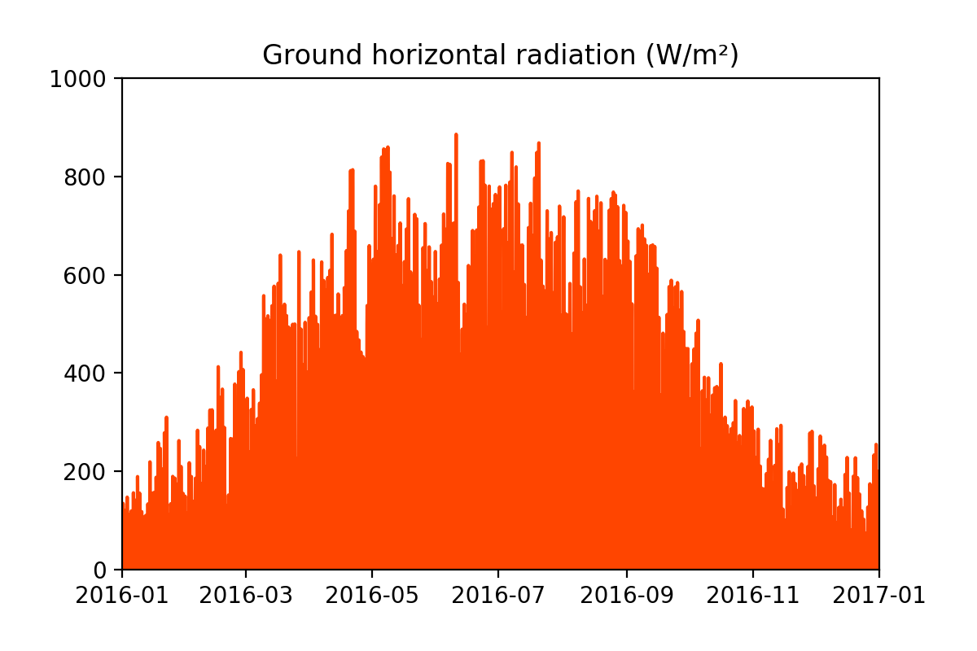
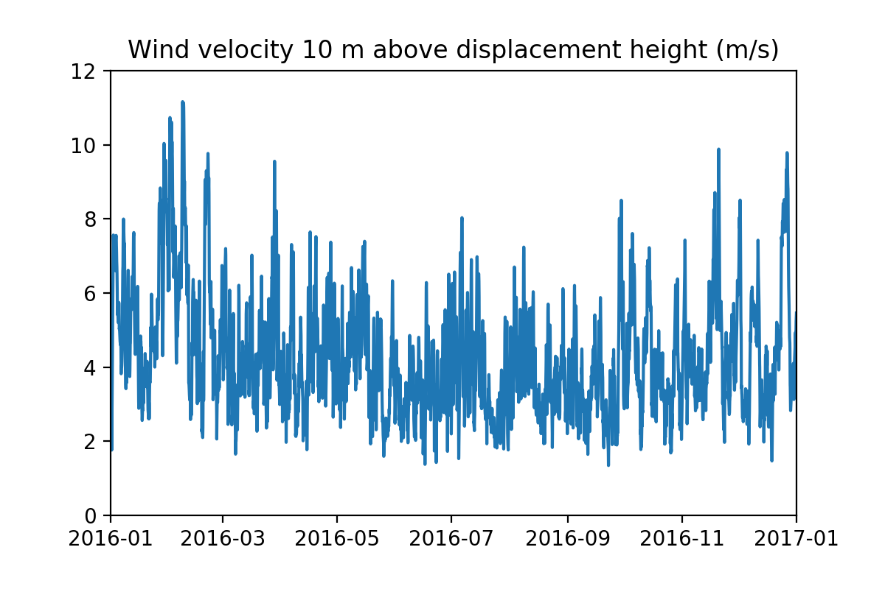
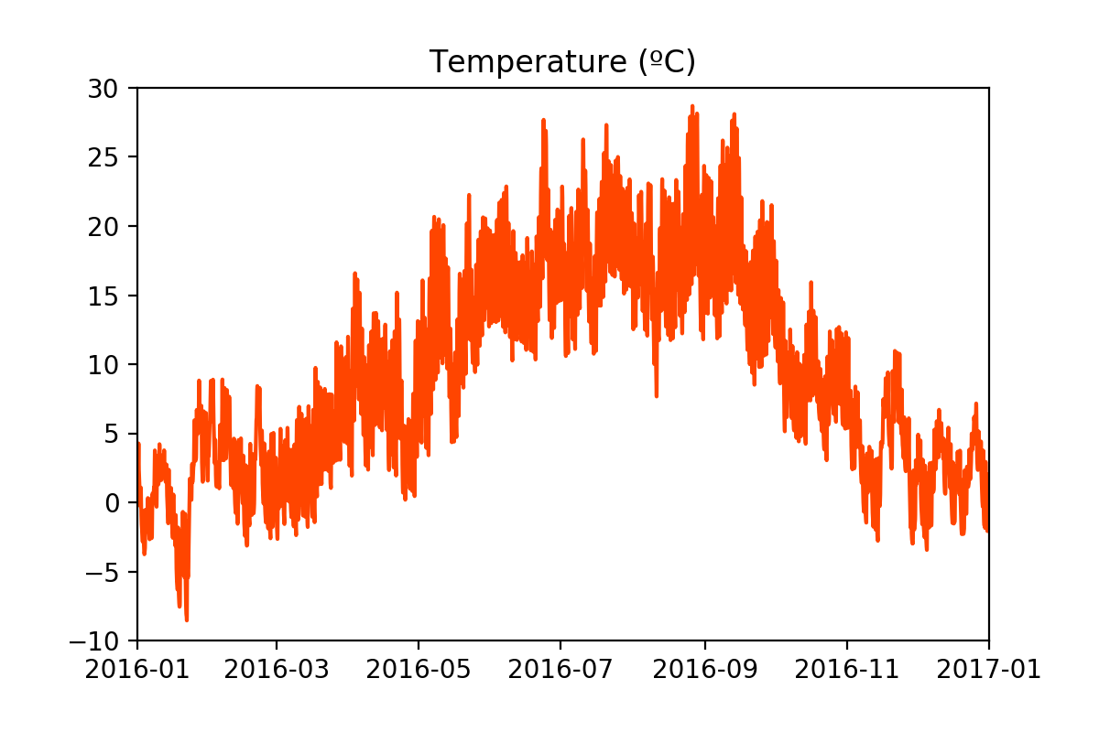
Plots to have an idea about weather data.

Slide 32
Analysis
As suggested by the plots from both datasets (and by common sense), there seems to be some correlation between the wind and solar generation and some of the measured weather quantities. Further evidence for this claim can be obtained from the following plots, in which the wind and solar generation is shown as a function of the several weather quantities.

Slide 33
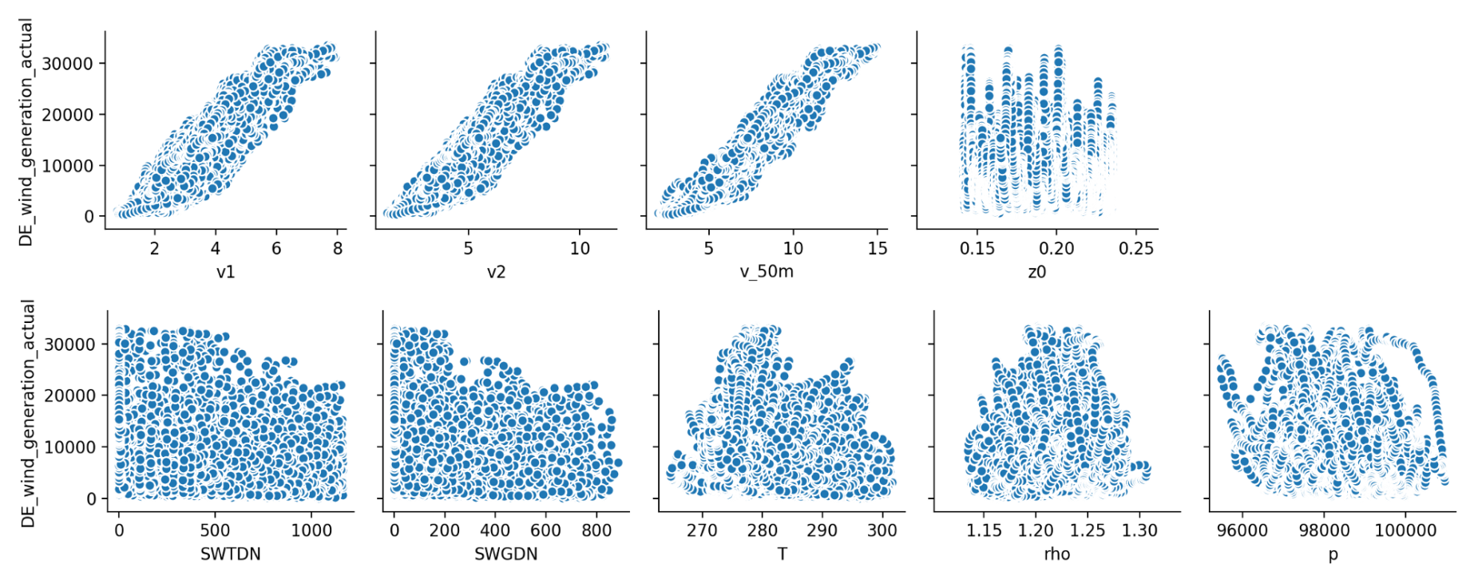
There seems to be a linear relation between the wind generation and the wind velocities v1, v2 and v_50m, but not the other quantities.

Slide 34
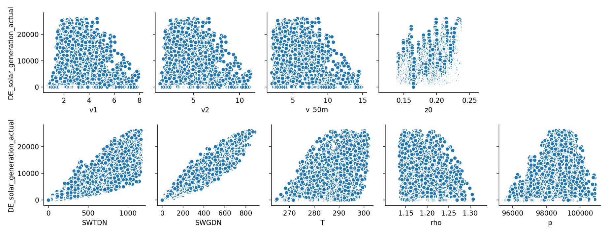
Similarly, there seems to be a linear relation between the solar generation and the top-of-the-atmosphere and ground radiation.

Slide 35
Predicting the wind and solar generation using linear regression
The output of a linear regression algorithm is a linear function of the input:
where beta is a vector of parameters.
The objective is to find the parameters which minimize the mean squared error:
This can be achieved usingLinearRegression from the scikit-learn library.

Slide 36
#import necessary modules
from sklearn.linear_model import LinearRegression
from sklearn.model_selection import cross_val_score
# instantiate LinearRegression
lr = LinearRegression()
In order to evaluate the performance of the algorithm, we divide the data using a procedure called cross-validation (CV for short). For the k-fold CV, the dataset is split into k smaller sets or ‘folds’, the model is trained in k-1 of those folds, and the resulting model is validated on the remaining part of the data. The performance measure provided by the CV is then the average of the performance measure computed in each experiment.

Slide 37
Electron js
Electron(formerly known as Atom Shell) is an open-source framework developed and maintained by GitHub Electron allows for the development of desktop GUI applications using web technologies: It combines the Chromium rendering engine and the runtime. Electron is the main GUI framework behind several notable open-source projects including
Atom,Github, Light Table, Visual Studio Code and WordPress Desktop.

Slide 38
Python Shell
A simple way to run Python scripts from Node.js with basic but efficient inter-process communication and better error handling.
Features
Reliably spawn Python scripts in a child process
Built-in text, JSON and binary modes
Custom parsers and formatters
Simple and efficient data transfers through stdin and stdout streams
Extended stack traces when an error is thrown Installation
npm install python-shell

Slide 39
Weather API
Dark Sky API
Open weather API.

Slide 40
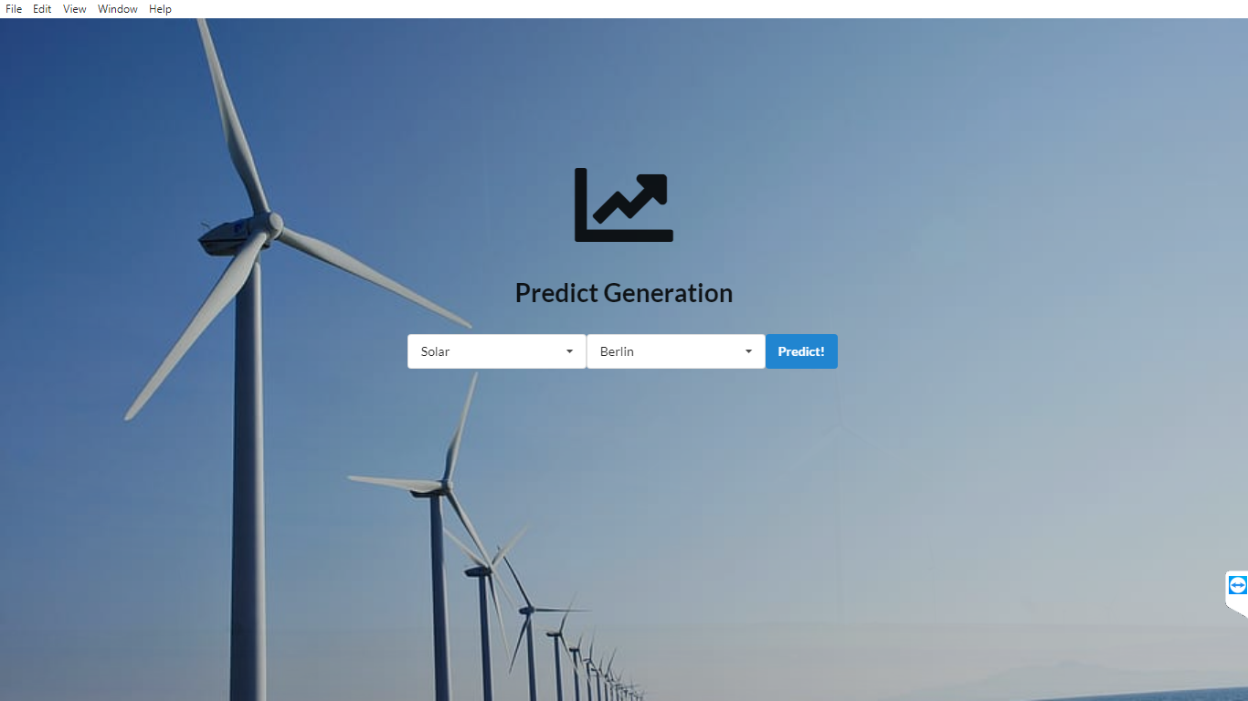
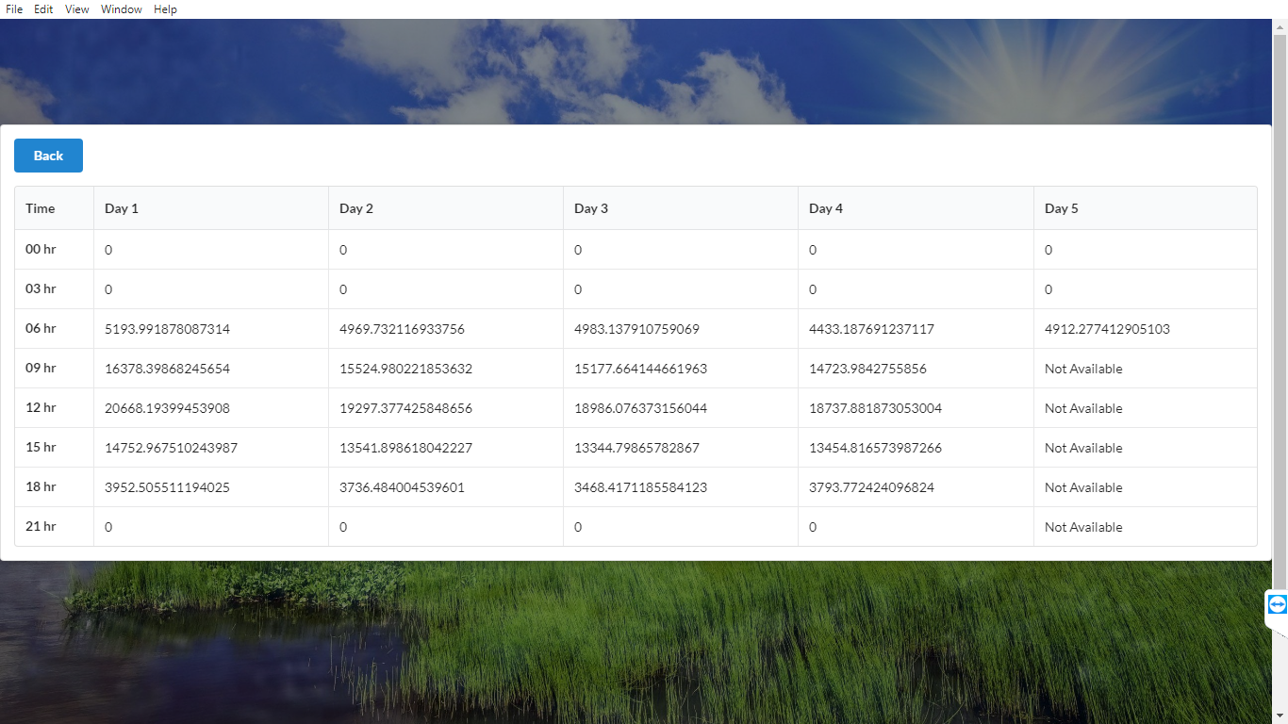
Screenshots

Slide 41
Thank you!

